Slide 1
Lab Meeting 7/16/19
Bryce Askey

Slide 2
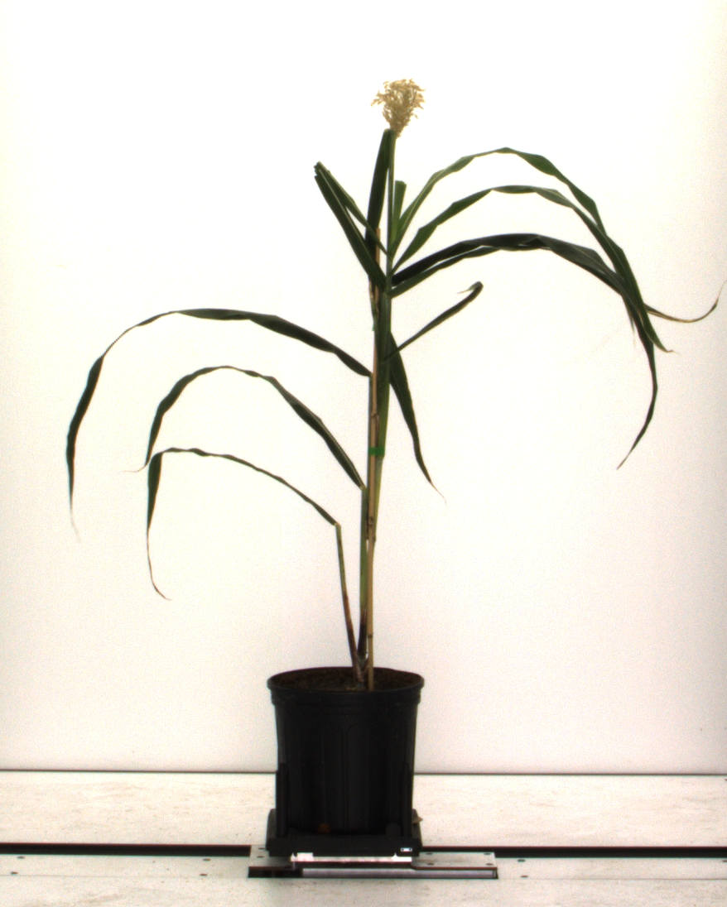
Sorghum QTL Mapping - Background
1. Calculate phenotypic parameters from hyperspectral and RGB images
2. Match phenotypic variations with presence/absence of markers in DNA (SNPs)
Result: Identification of areas of sorghum genome which control for economically valuable traits

Slide 3
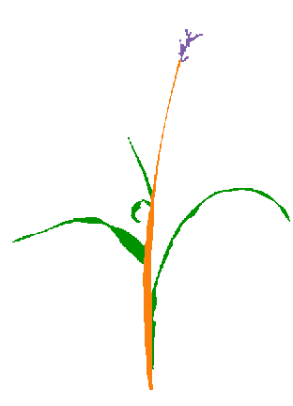
Traits to Identify
General plant shape:
Stalk height – distance from bottom of stalk to flag leaf node
# of leaves
Leaf angle
Panicle characteristics:
Panicle size – area of convex hull surrounding panicle
Panicle openness – empty area in convex hull / total area
Panicle exsertion – distance from flag leaf node to base of panicle

Slide 4
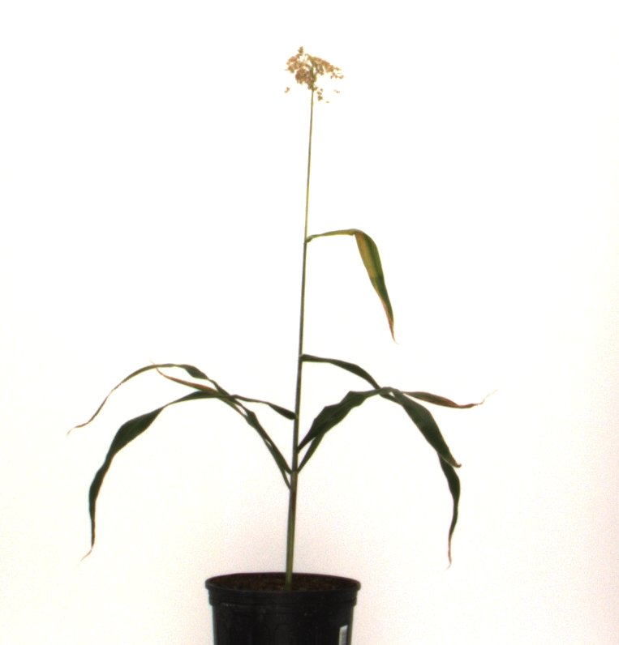
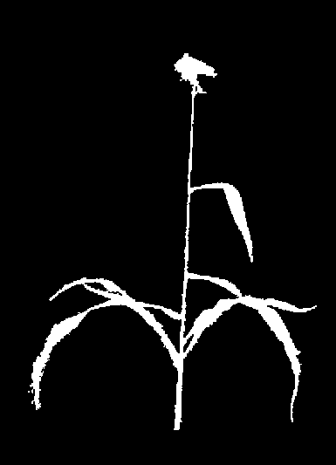
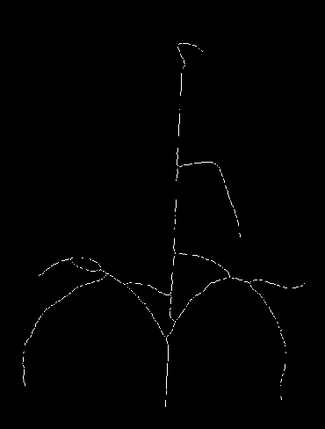
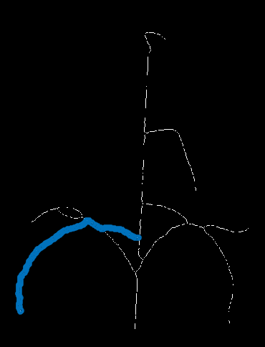
RGB Image Processing – Leaf Angle
Method to separate overlapping leaves:
  Skeletonize image
  Identify leaf tips
  Trace all possible paths back to stalk
  Choose smoothest path

Slide 5
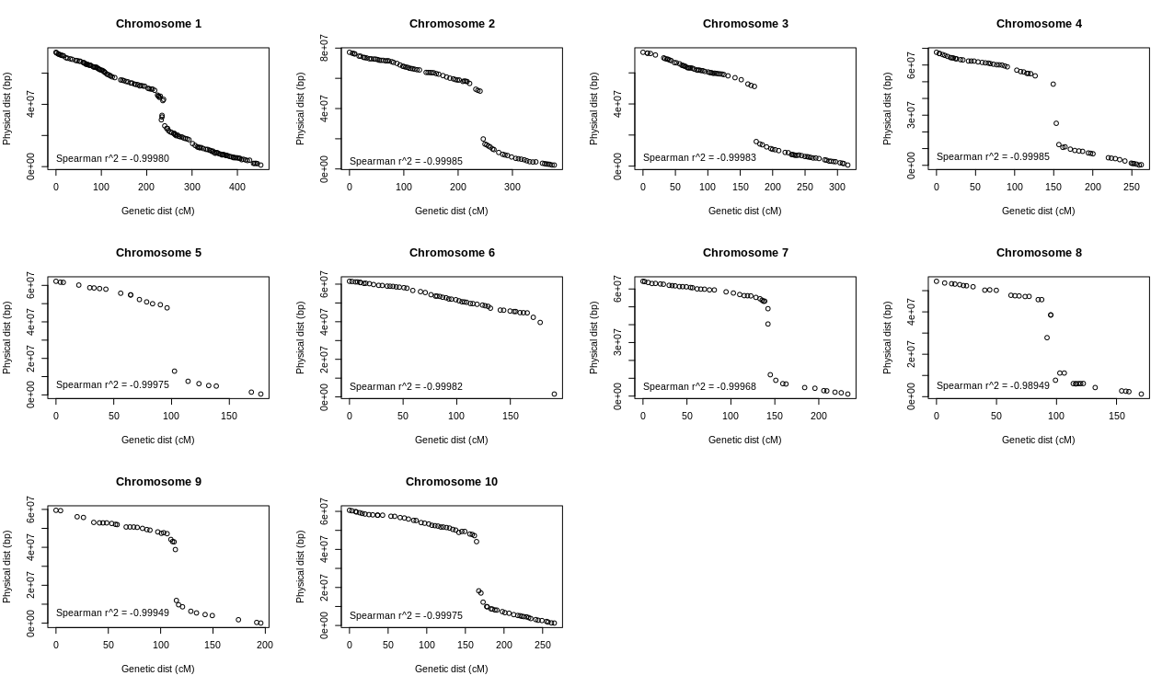
QTL Mapping – Genetic Map

Slide 6
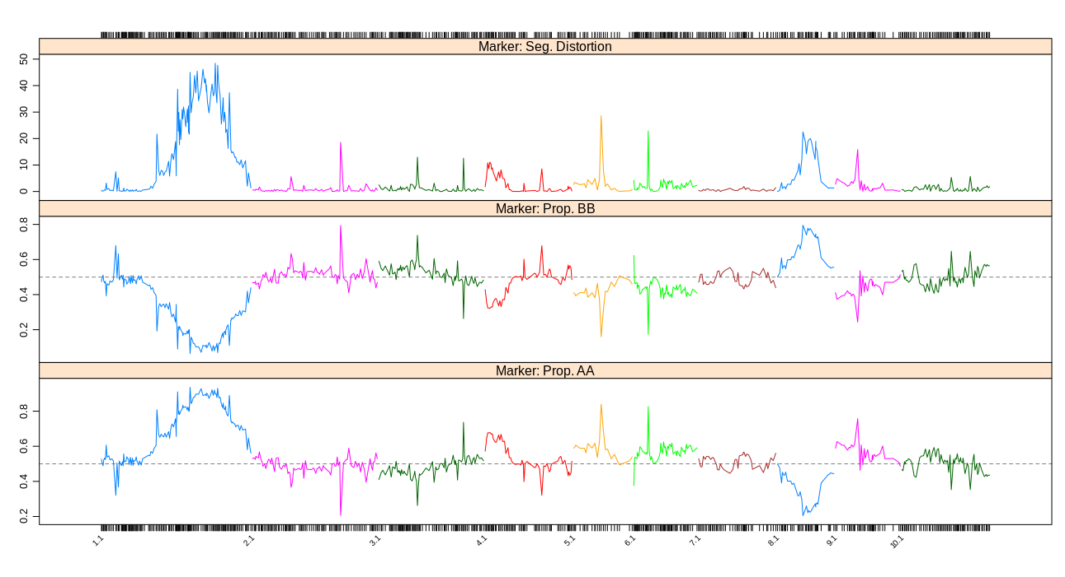
QTL Mapping – Segregation Distortion

Slide 7
QTL Mapping – Model Selection
Multiple QTL approach:
Identify additive QTL, and any interactions between QTL for each phenotypic trait
Procedure:
Calculate penalties for LOD scores
  - Additional QTL will always increase LOD score of model
  - To minimize false positive selection of QTL, apply penalty
Stepwise model search
  - Forward selection – add QTL/interactions to model
  - Backward elimination – remove QTL/interactions from model
  - Calculate penalized LOD score after each change
Estimate effect of each QTL/interaction on phenotype

Slide 8
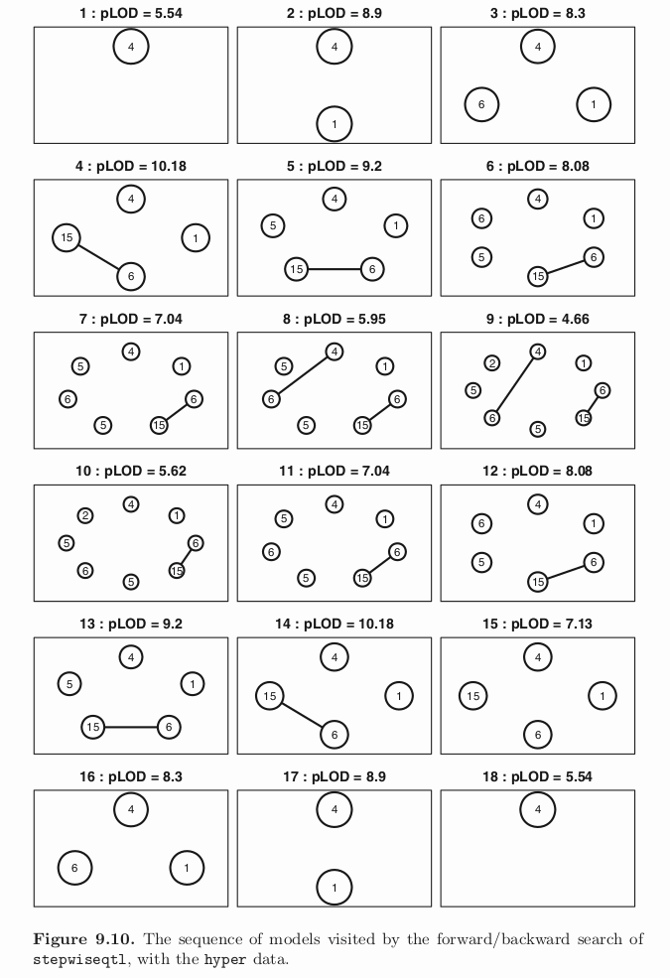
Stepwise Example
From Broman et al (2009):
Circles represent possible QTL
  - Numbers = chromosome #
Lines represent interactions between QTL

